Slide 1







Stackoverflow Developer Survey Data Analysis
Duong Van Nhat Long
Date: 04/03/2024

Slide 2



OUTLINE
Executive Summary
Introduction
Methodology
Results
Visualization – Charts
Dashboard
Discussion
Findings & Implications
Conclusion
Appendix

Slide 3

EXECUTIVE SUMMARY
Current Technology Usage
Top 10 Languages Worked with
Top 10 Database Worked with
Platform worked with Word-Cloud
Top 10 Web-frame Worked with
Future Technology Trend
Top 10 Languages Desired Next Year
Top 10 Database Desired Next Year
Platform worked with Desired Next Year
Top 10 Web-frame Desired Next Year
Demographics
Respondents Classified by Gender
Respondent Count for Countries
Respondent Count by Age
Respondent Count by Gender by Formal Education Level

Slide 4

INTRODUCTION
This presentation is designed for stakeholders and business decision-makers within a global IT and business consulting services firm.
Its purpose is to pinpoint forthcoming skill prerequisites within the global IT sector essential for the company to stay abreast of evolving technologies and sustain competitiveness.
Recommendations will be outlined based on the analysis conducted.

Slide 5

METHODOLOGY
Collecting Data: Utilizing the Stack Overflow Developer Survey API, Employing web scraping techniques to gather data.
Exploring Data: Investigating the collected data to understand its structure and content.
Finding Duplicates & Removing Duplicates: Identifying duplicate entries within the dataset and eliminating them to ensure data integrity.
Finding & Imputing Missing Values: Detecting missing values in the dataset and implementing strategies to fill in or impute these missing values.
Normalizing Data: Standardizing the data to a common scale to facilitate comparisons and analyses.
Handling Outliers: Identifying outliers within the dataset and employing appropriate methods to handle them, such as removing or transforming them.
Correlation: Analyzing the relationships between different variables in the dataset to understand their correlation and dependencies.
Visualization Data: Creating visual representations of the data to gain insights and communicate findings effectively.
Building Dashboard: Developing a dashboard interface to present the analyzed data in an interactive and user-friendly manner for further exploration and decision-making.

Slide 6
RESULTS

Slide 7
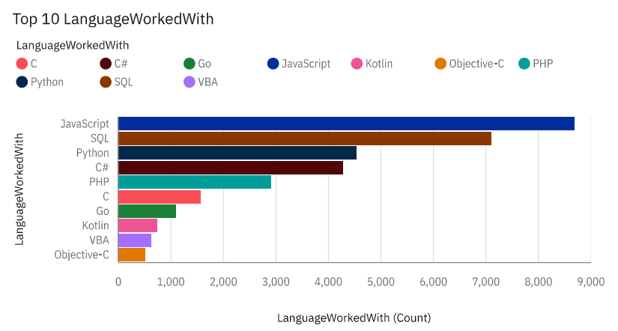
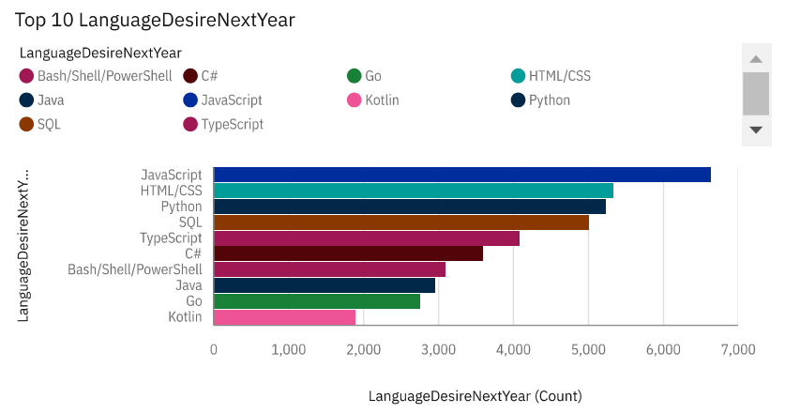
PROGRAMMING LANGUAGE TRENDS
Current Year
Next Year
< Bar chart of top 10 programming languages for the next year goes here.>

Slide 8
PROGRAMMING LANGUAGE TRENDS - FINDINGS & IMPLICATIONS
Findings
JavaScript and SQL retain their positions as the top two most popular programming languages for the current and JavaScript and HTML/CSS upcoming year.
Python and TypeScript are experiencing increased interest for the following year.
Conversely, interest in SQL and Bash/Shell/PowerShell has declined.
Implications
You can maintain a similar number of employees skilled in JavaScript and HTML/CSS.
You can increase the number of employees skilled in Python and TypeScript.
You can decrease the number of employees skilled in SQL and Bash/Shell/PowerShell.

Slide 9
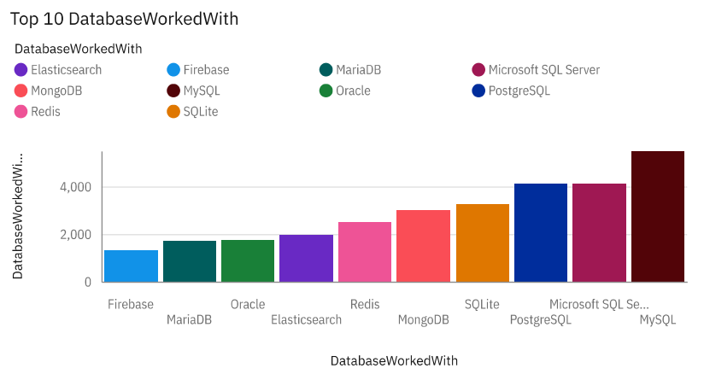
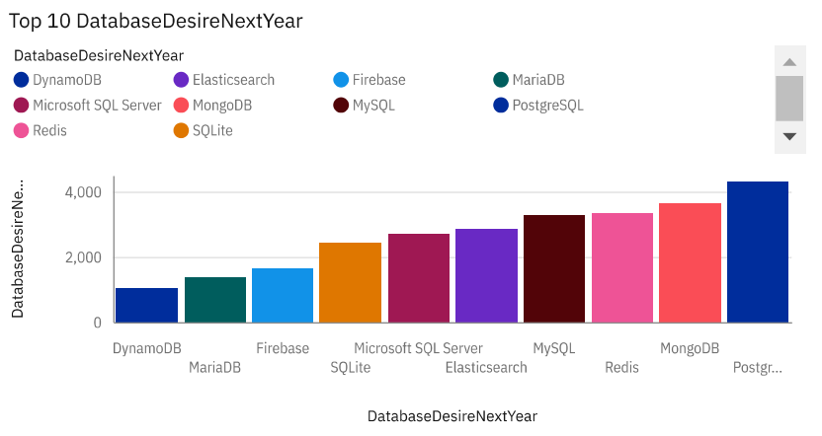
DATABASE TRENDS
Current Year
Next Year

Slide 10
DATABASE TRENDS - FINDINGS & IMPLICATIONS
Findings
Interest in MySQL, Microsoft SQL Server, and SQLite has decreased for the upcoming year.
Interest in PostgreSQL and MongoDB has increased compared to the current year.
There is increased interest in Redis and Elasticsearch for the following year.
Implications
You can decrease the number of employees skilled in MySQL, Microsoft SQL Server, and SQLite.
You can increase the number of employees skilled in PostgreSQL and MongoDB.
You can also employ more people skilled in Redis and Elasticsearch.

Slide 11

DASHBOARD
https://ap1.ca.analytics.ibm.com/bi/?perspective=dashboard&pathRef=.my_folders%2FIBM%2BData%2BAnalyst%2BCapstone%2BProject_WEEK5&action=view&mode=dashboard

Slide 12
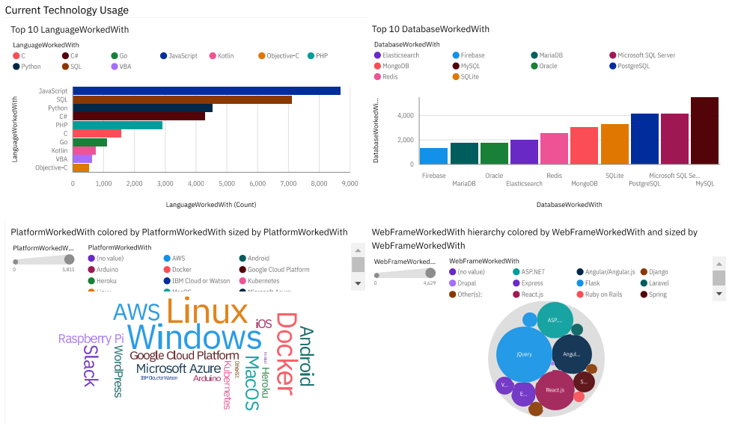
DASHBOARD TAB 1

Slide 13
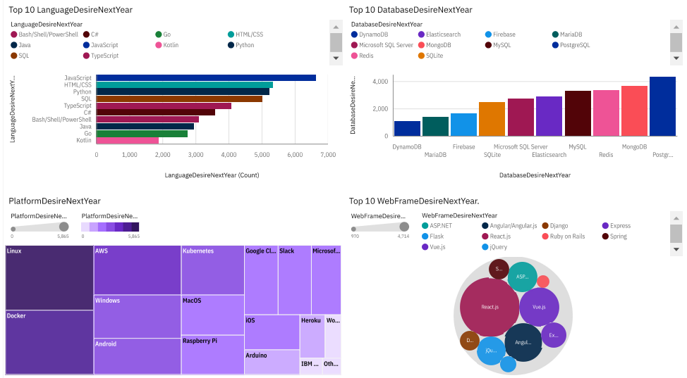
DASHBOARD TAB 2

Slide 14
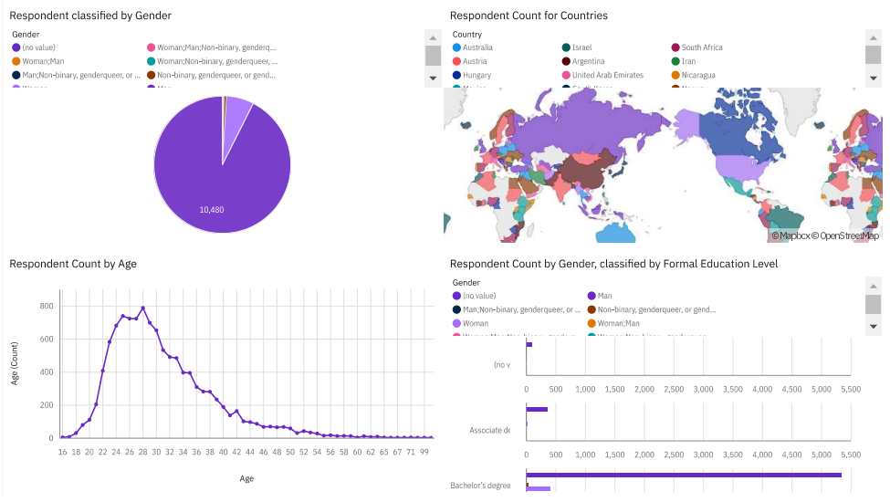
DASHBOARD TAB 3

Slide 15
DISCUSSION
The survey included respondents of all ages.
All genders were considered in the survey.
Participants from various countries were asked to participate in the survey.
Individuals with different education levels were also included in the survey.

Slide 16
OVERALL FINDINGS & IMPLICATIONS
Findings
Over 90 percent of the respondents in the survey are male.
The average age of the participants is 30.
There is a notable increase in interest in TypeScript, alongside continued growth in Python.
Redis, Elasticsearch, PostgreSQL, and MongoDB are experiencing heightened interest.
Interest in Slack and Windows is notably declining.
Vue.js is seeing a significant rise in interest, while React.js continues to grow steadily.
Implications
The software sector continues to exhibit a male-dominated landscape.
Locating highly experienced professionals in development remains a persistent challenge.
It's advisable to maintain a stable workforce proficient in JavaScript and HTML/CSS while increasing recruitment for Python and TypeScript expertise.
Furthermore, consider bolstering your team with more talent specialized in PostgreSQL, MongoDB, Elasticsearch, and Redis.
In the realm of web development, ensure sufficient staffing for ASP.NET while augmenting the team with skilled Vue.js and React.js practitioners.
In terms of infrastructure, sustain your Linux workforce while expanding the team with Docker, AWS, and Android experts, while scaling back reliance on Slack and Windows.

Slide 17

CONCLUSION
Up to now, the software industry is still largely influenced by male dominance. Finding highly experienced development professionals remains a challenge for many organizations.
To meet the growing market demand, maintaining a solid team in JavaScript and HTML/CSS is necessary, but there is also a need to increase recruitment of people with skills in Python and TypeScript. This reflects the upward trend of TypeScript and the stability of Python in the industry.
At the same time, to meet the needs of modern software projects, expanding the team with people skilled in PostgreSQL, MongoDB, Elasticsearch and Redis is necessary. This represents a shift from traditional DBMSs to more popular and high-performance solutions such as MongoDB and Elasticsearch.

Slide 18

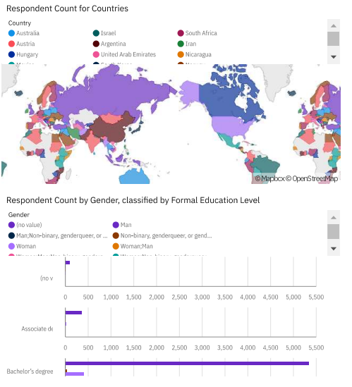
APPENDIX

Slide 19
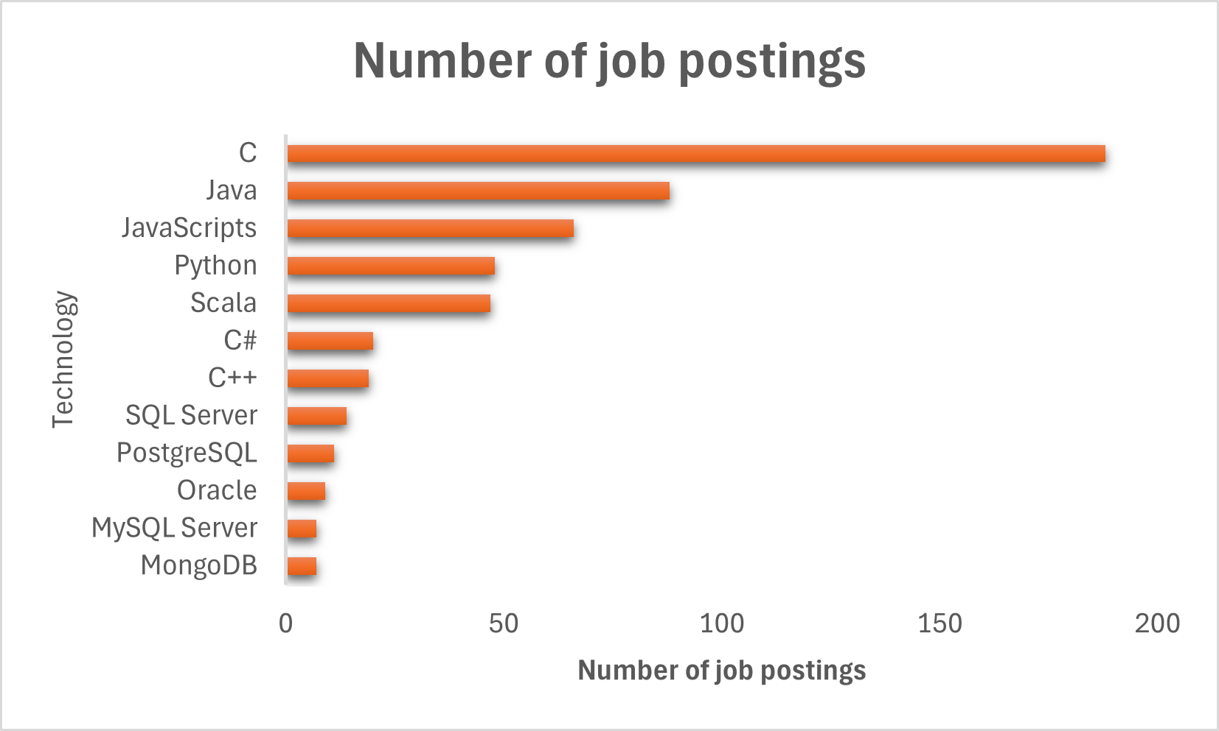
JOB POSTINGS

Slide 20
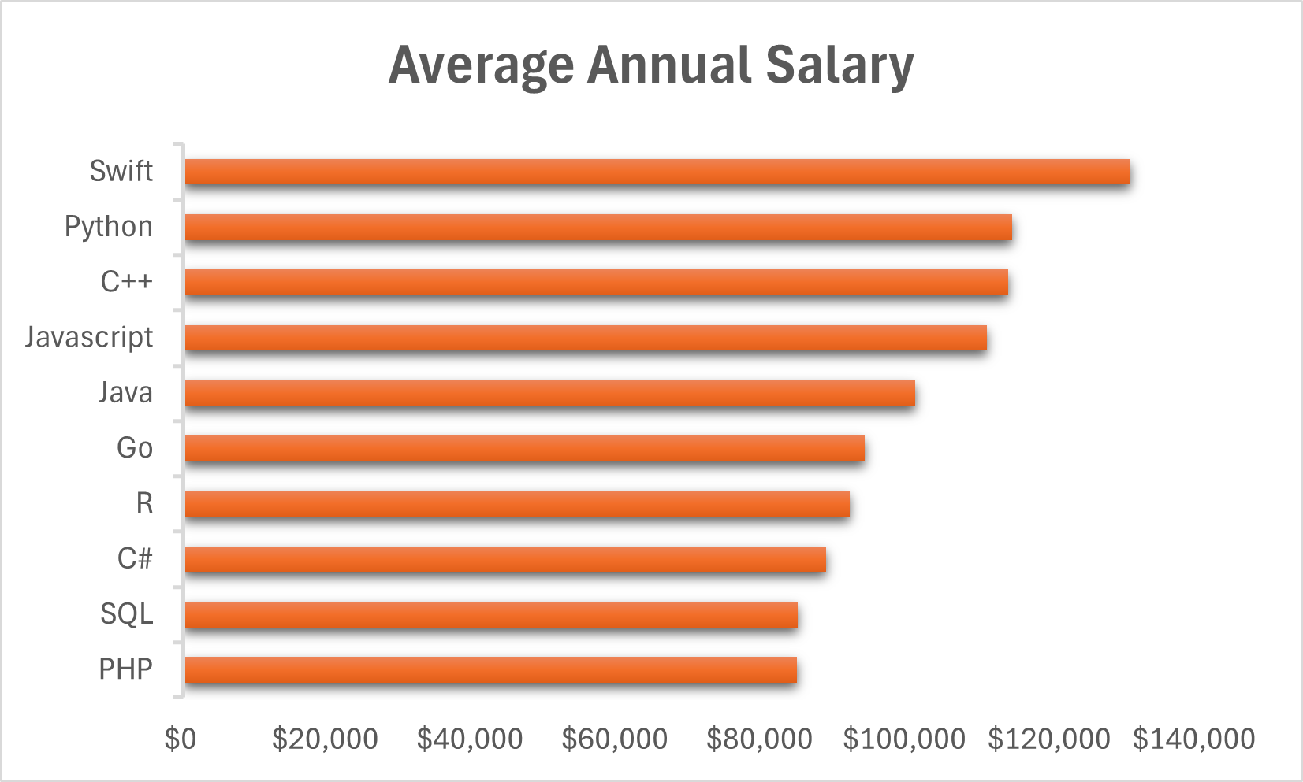
POPULAR LANGUAGES

